Slide 1
Lecture 5 Language Models
August 30th / 2023

Slide 2
Lecture Overview
Cheaha (getting started)
Language Models

Slide 3
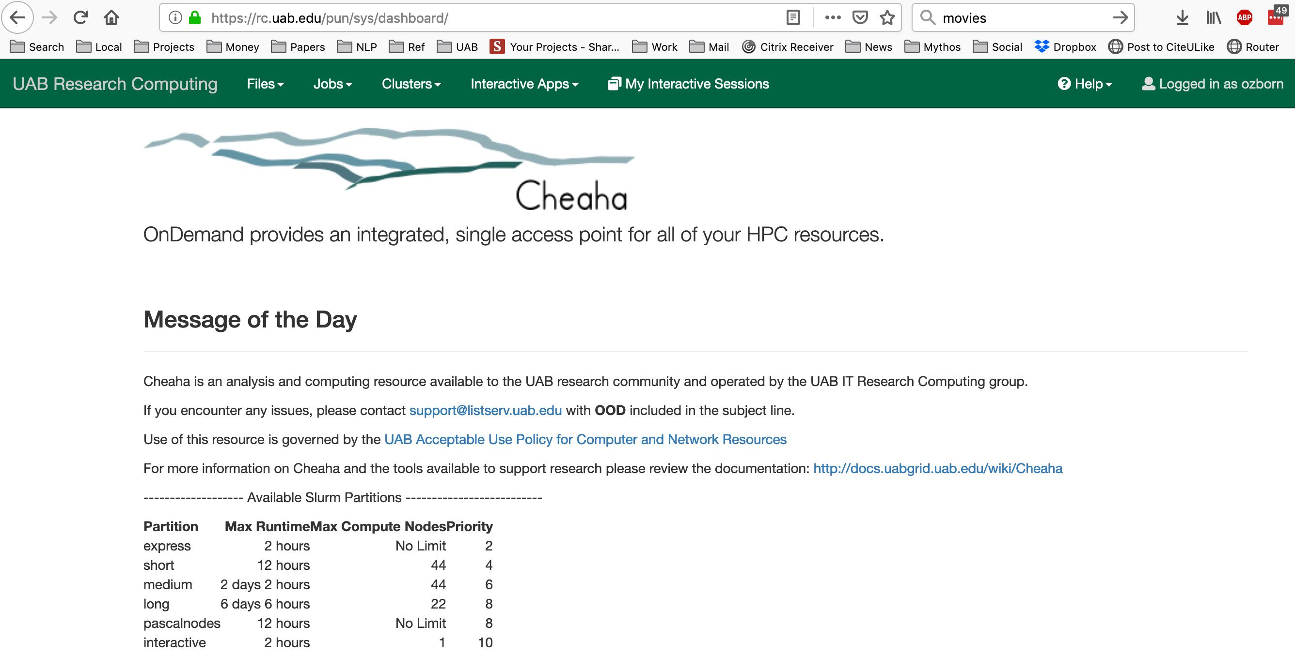

Slide 4
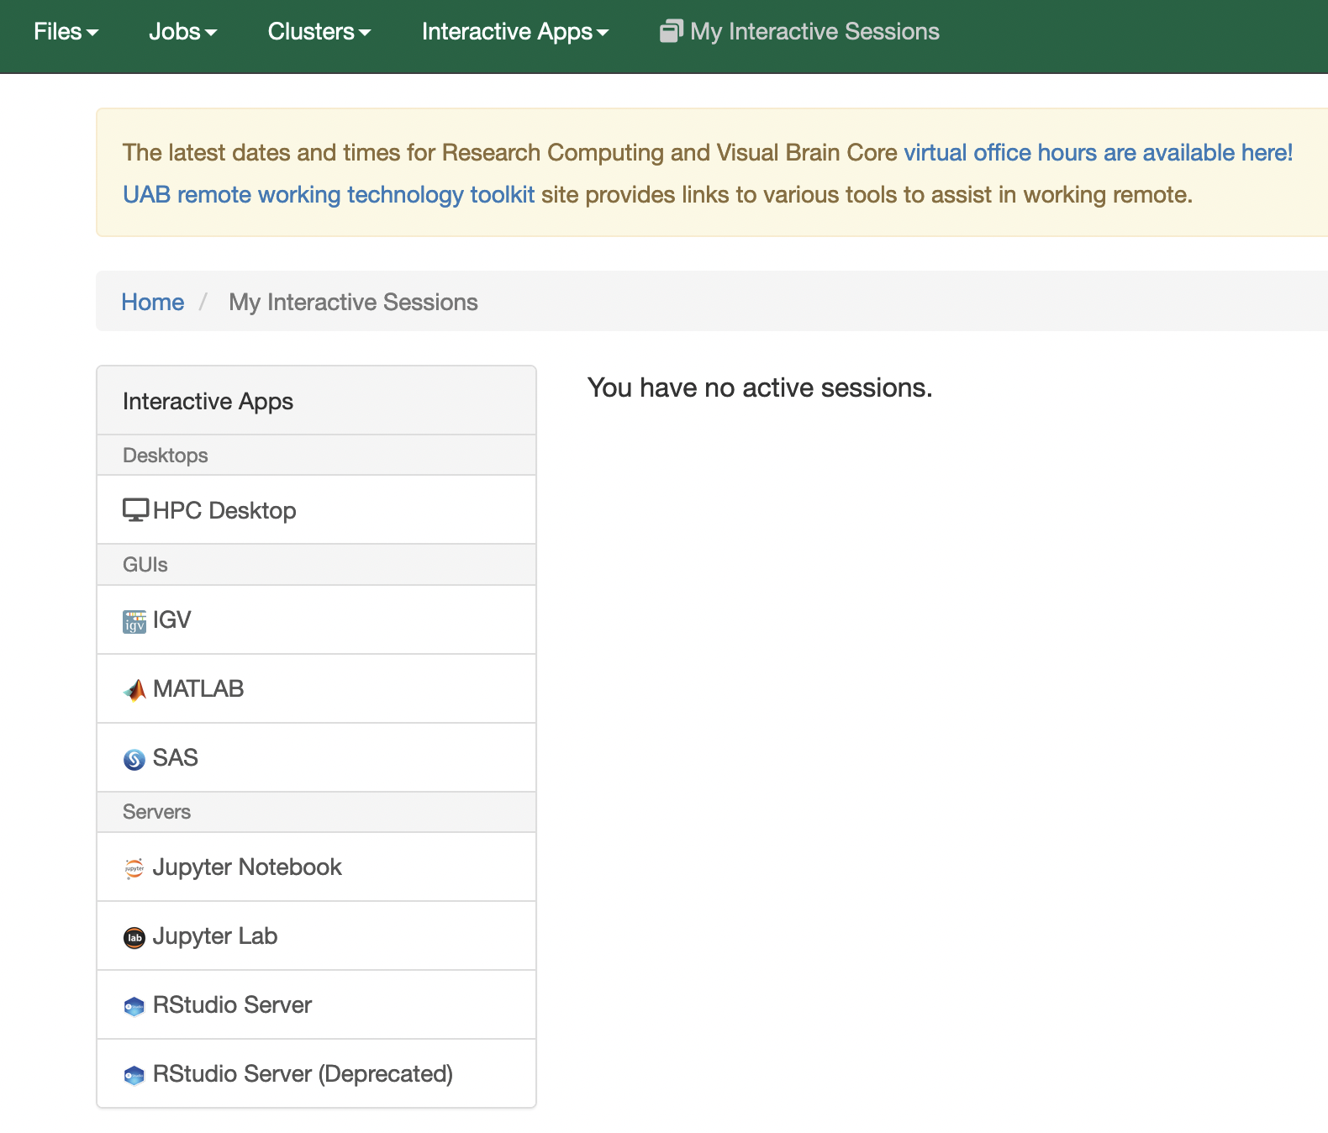

Slide 5
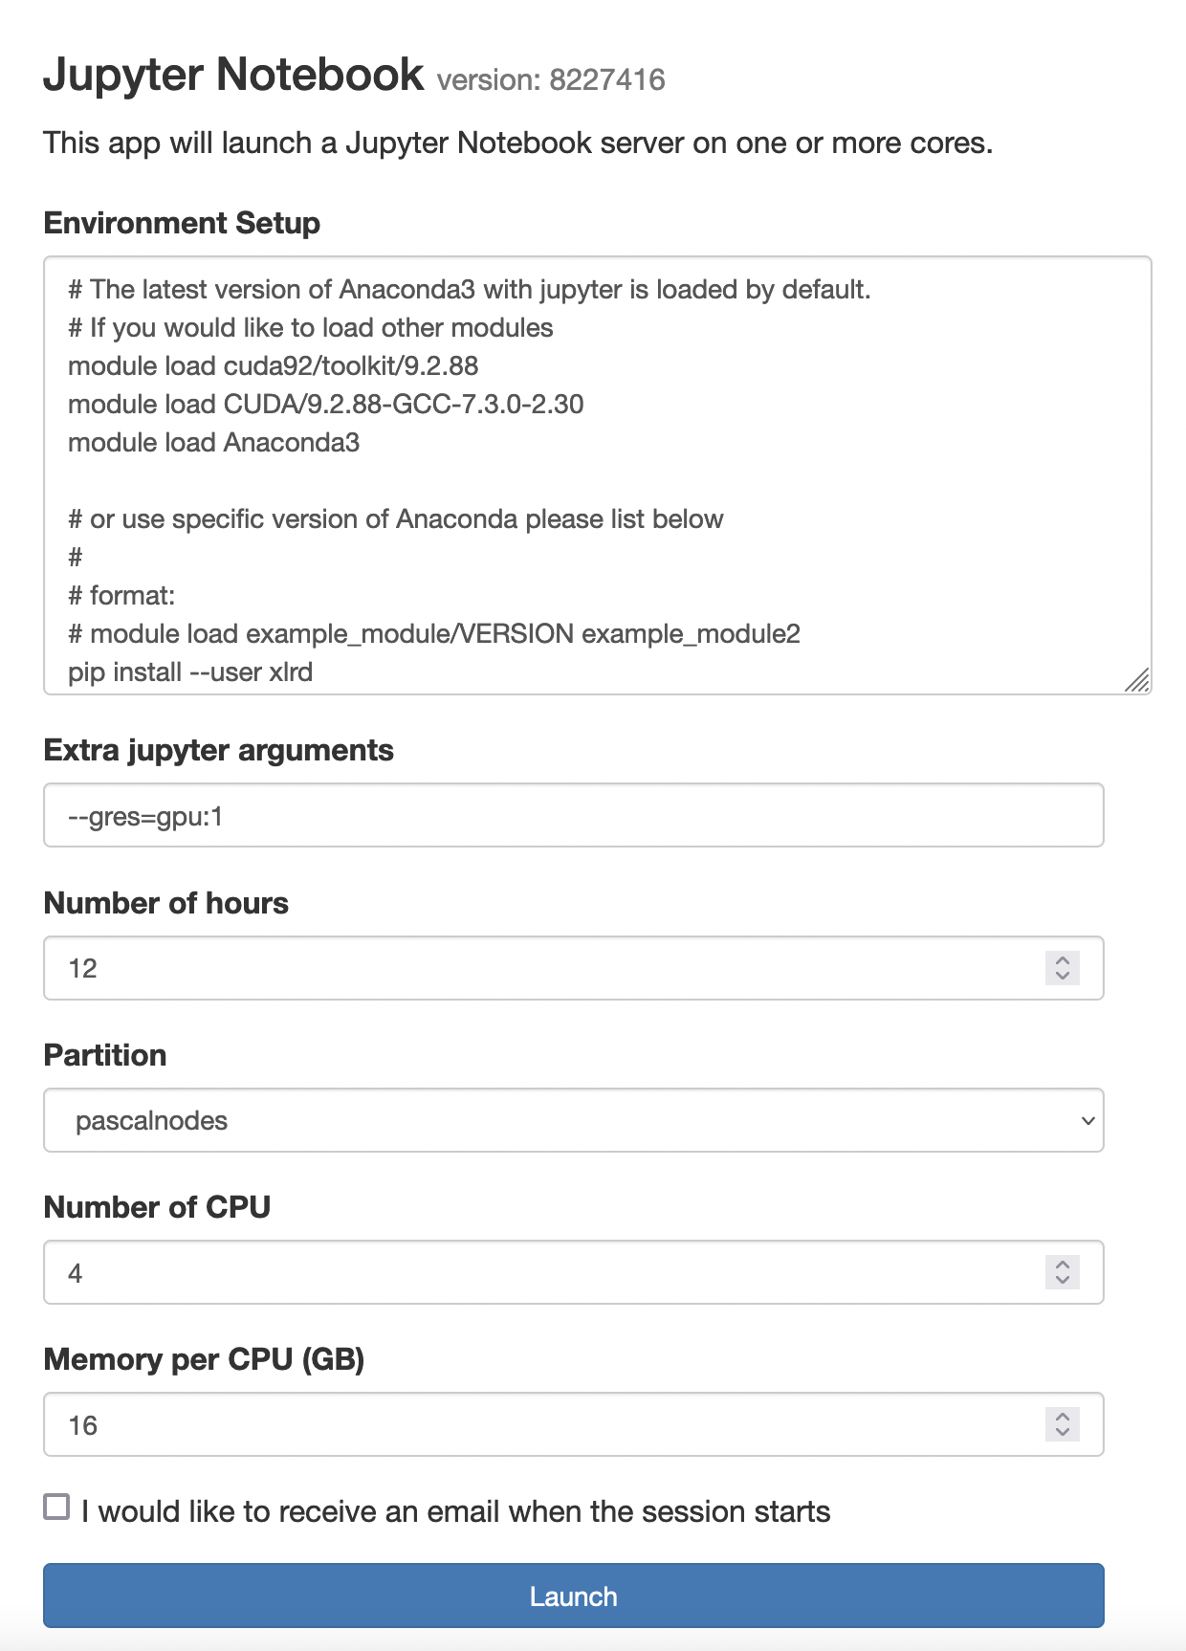
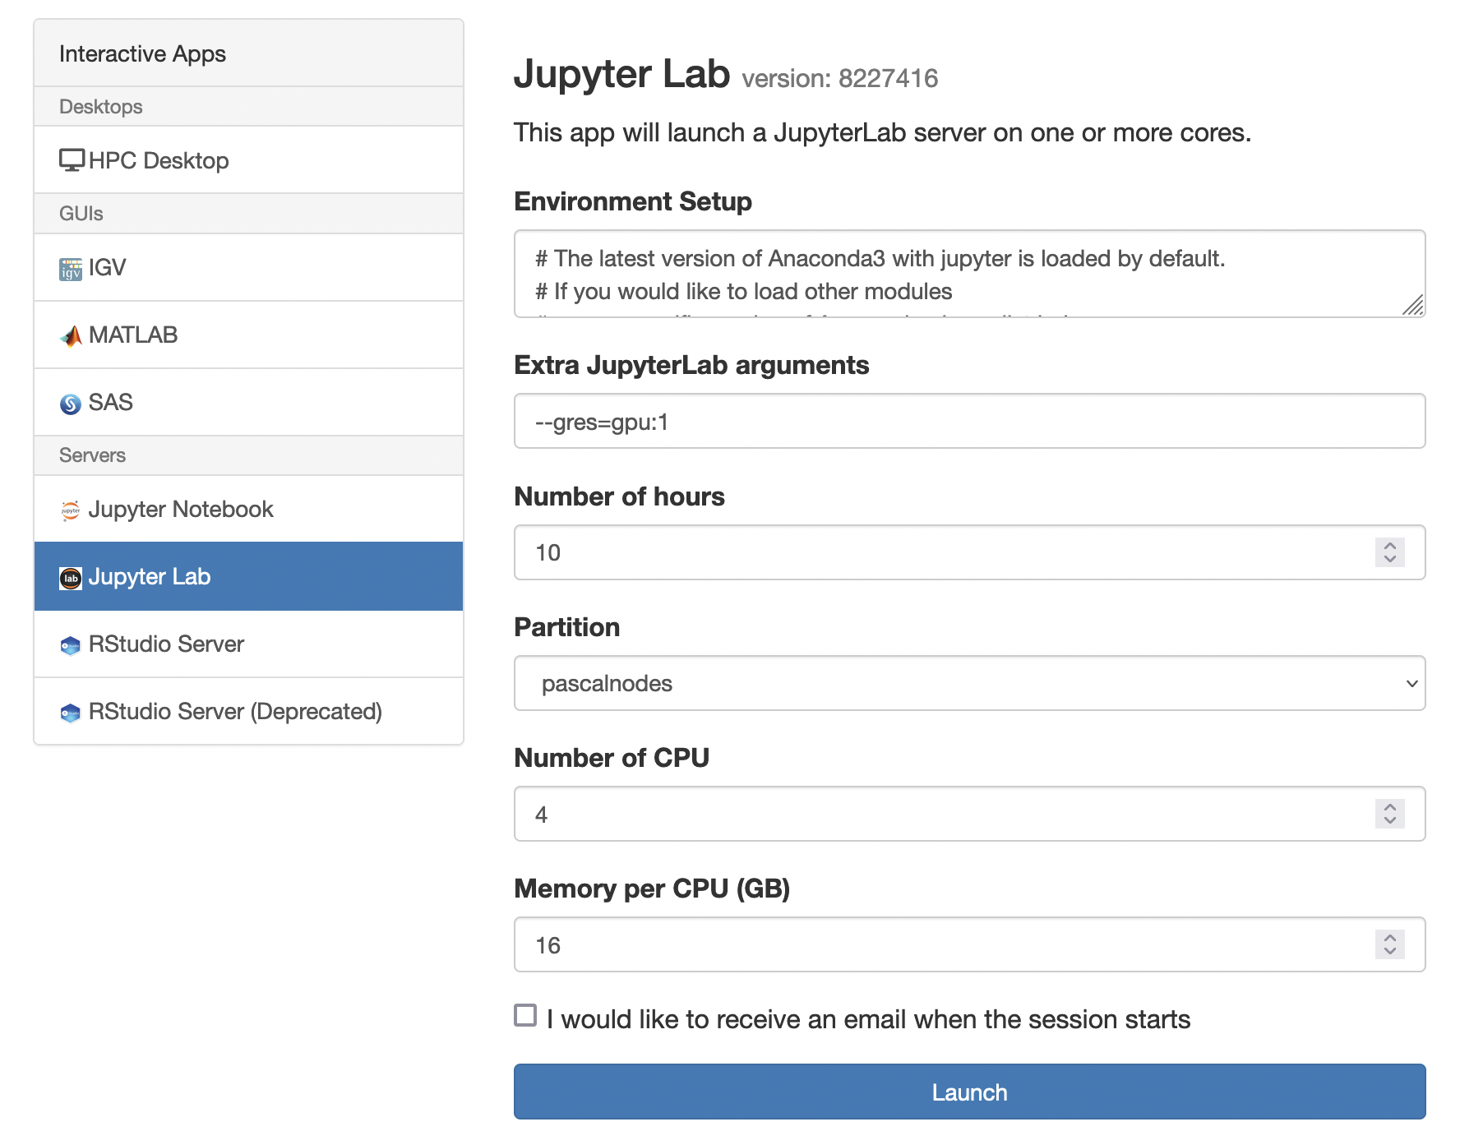

Slide 6
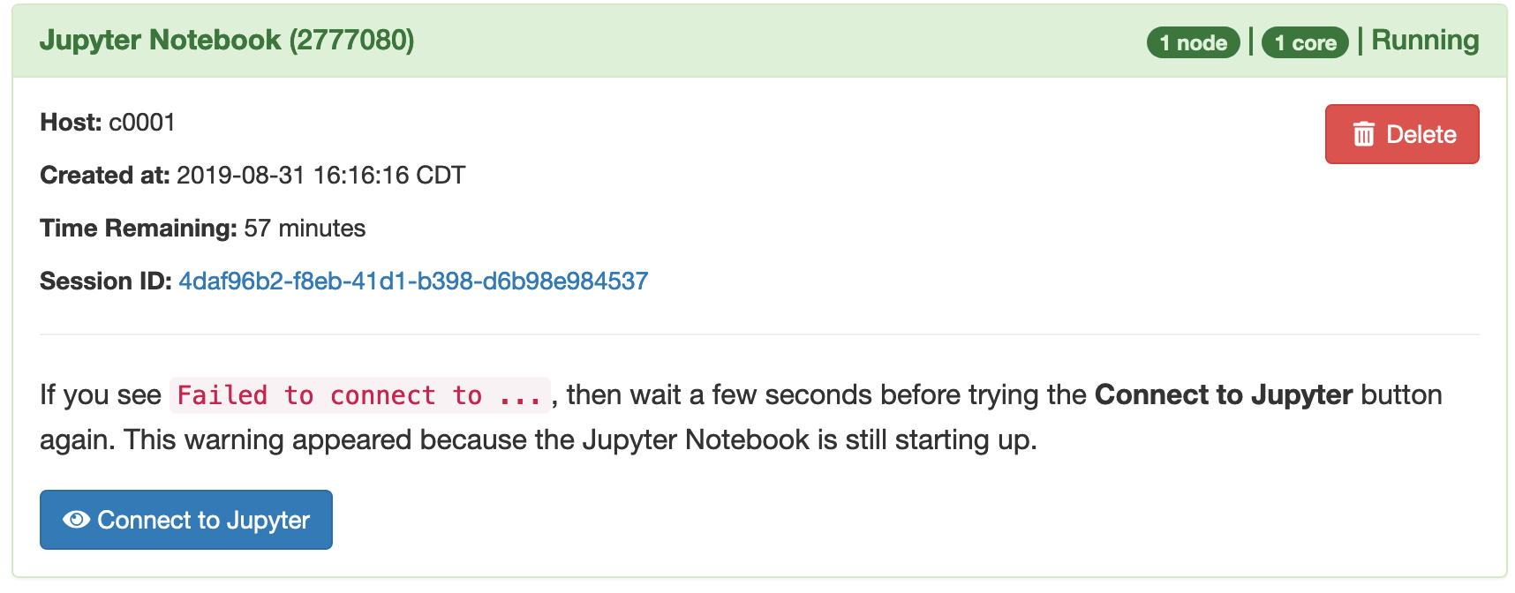
Connect to Jupyter
Notes:
May need to wait a bit

Slide 7
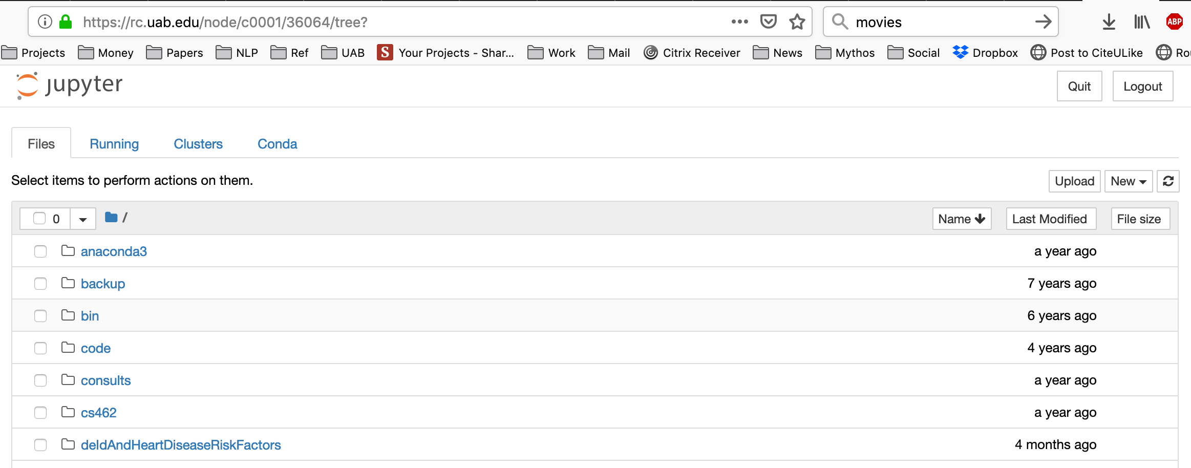
Cheaha Home Directory

Slide 8
Language Model
Definition (Wikipedia)
“A statistical language model is a probability distribution over sequences of words.”
Input:
Sequence of n words
Output
P (w₁, w₂, w₃…w_{n})

Slide 9
Why do people care about language models?
Autocomplete on your favorite texting app
What is the probability of the next word?
Spelling Correction
Thnk you -> Thank you
Audio recognition
“recognize speech" and "wreck a nice beach" sound similar, but mean different things. “ (Wikipedia)
Question Answering
?
Many more…
Notes:
Machine Translation
Natural Language Generation

Slide 10
Generative Models
Language Models
Naïve Bayes Bigram Model
Markov Chains
(biological sequences)
BERT-Base-Uncased
(110M)
GPT-4
PaLM
LLaMa2
GatorTron
(8.9B parameters)(
DALL-E
Any large non-generative sequence model ex) Hospital Trajectory model
Large Models
Notes:
“Language Model Replacemenet”

Slide 11
Language Model Development
“Classic” Language Model
Language Model “Replacement”
Typically, N-Gram based models
Gives a probability distribution over a sequence of words (by definition)
Use probability distribution to make useful predictions for a variety NLP tasks
Some Neural Net based models
BERT and T5
Sometimes called masked language models (MLM) when masking is used as a training objective (common) or continuous space language models
Does not provide a probability distribution, but learns to predict one
Generates predictions useful for a variety of NLP tasks
Can serve as a “drop in replacements” for traditional language models

Slide 12
Casual Language Models
In the context of neural network models Language Models are sometimes referred to as “casual language models”
This distinguishes them from masked language models (MLM) because they are prediction a token given a series of tokens, unlike a MLM.
We will learn about MLM later on, but for now know that all language models are casual language models
For folks who want to get a head start on how these models are built, see https://huggingface.co/course/chapter7/6?fw=pt

Slide 13
Probabilistic Language Modeling
Goal: compute the probability of a sentence or sequence of words:
P(W) = P(w₁,w₂,w₃,w₄,w₅…w_{n})
Related task: probability of an upcoming word:
P(w₅|w₁,w₂,w₃,w₄)
A model that computes either of these:
P(W) or P(w_{n}|w₁,w₂…w_{n-1}) is called a language model

Slide 14
How to compute P(W)
How to compute this joint probability:
P(its, water, is, so, transparent, that)
Intuition: let’s rely on the Chain Rule of Probability

Slide 15
Reminder: The Chain Rule
Recall the definition of conditional probabilities
p(B|A) = P(A,B)/P(A) Rewriting: P(A,B) = P(A)P(B|A)
More variables:
P(A,B,C,D) = P(A)P(B|A)P(C|A,B)P(D|A,B,C)
The Chain Rule in General
P(x₁,x₂,x₃,…,x_{n}) = P(x₁)P(x₂|x₁)P(x₃|x₁,x₂)…P(x_{n}|x₁,…,x_{n-1})
Notes:
Make sure students understand symbols
B given A
P(A,B) is a 2-mer sequence probability

Slide 16
The Chain Rule applied to compute joint probability of words in sentence
P(“its water is so transparent”) =
P(its) × P(water|its) × P(is|its water)
× P(so|its water is) × P(transparent|its water is so)
Notes:
Joint probability = is a statistical measure that calculates the likelihood of two events occurring together and at the same point in time

Slide 17
How to estimate these probabilities
Could we just count and divide?
No! Too many possible sentences!
We’ll never see enough data for estimating these
Notes:
What would we count?
Does this make sense?

Slide 18

Markov Assumption
Simplifying assumption:
Or maybe
Andrei Markov

Slide 19
Markov Assumption
In other words, we approximate each component in the product
Notes:
Have student walk through formula, translate to English

Slide 20
Simplest case: Unigram model
Some automatically generated sentences from a unigram model
fifth, an, of, futures, the, an, incorporated, a, a, the, inflation, most, dollars, quarter, in, is, mass
thrift, did, eighty, said, hard, 'm, july, bullish
that, or, limited, the
Notes:
Read out sentence
Looks horrible and random

Slide 21
Bigram model
Condition on the previous word:
texaco, rose, one, in, this, issue, is, pursuing, growth, in, a, boiler, house, said, mr., gurria, mexico, 's, motion, control, proposal, without, permission, from, five, hundred, fifty, five, yen
outside, new, car, parking, lot, of, the, agreement, reached
this, would, be, a, record, november

Slide 22
N-gram models
We can extend to trigrams, 4-grams, 5-grams
In general, this is an insufficient model of language
because language has long-distance dependencies:
“The computer(s) which I had just put into the machine room on the fifth floor is (are) crashing.”
But we can often get away with N-gram models

Slide 23
Language Modeling
Introduction to N-grams

Slide 24
Language Modeling
Estimating N-gram Probabilities

Slide 25
Estimating bigram probabilities
The Maximum Likelihood Estimate
Notes:
Of all the times you see the word i-1 how frequently does w I follow?
All count c for brevity

Slide 26
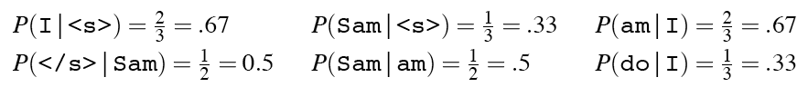
An example
P(am|I) = ?
<s> I am Sam </s>
<s> Sam I am </s>
<s> I do not like green eggs and ham </s>
Notes:
What is asked for in English? Probability of am, given the preceding word i
What is it? 2/3rds

Slide 27
More examples: Berkeley Restaurant Project sentences
can you tell me about any good cantonese restaurants close by
mid priced thai food is what i’m looking for
tell me about chez panisse
can you give me a listing of the kinds of food that are available
i’m looking for a good place to eat breakfast
when is caffe venezia open during the day

Slide 28
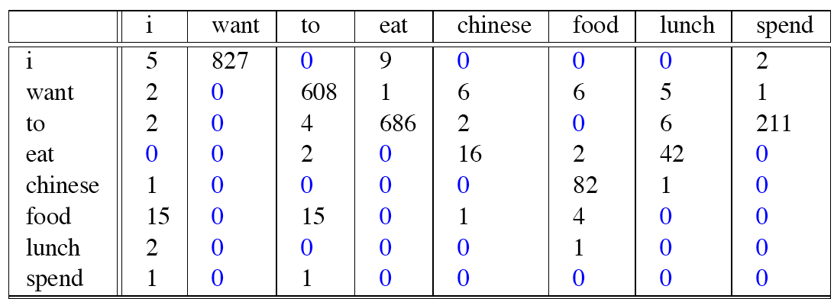
Raw bigram counts
Out of 9222 sentences
Notes:
Bigram – which axis? (Preceding word is vertical or horizontal?) i want...
What other features does this matrix have? Sparsity…

Slide 29
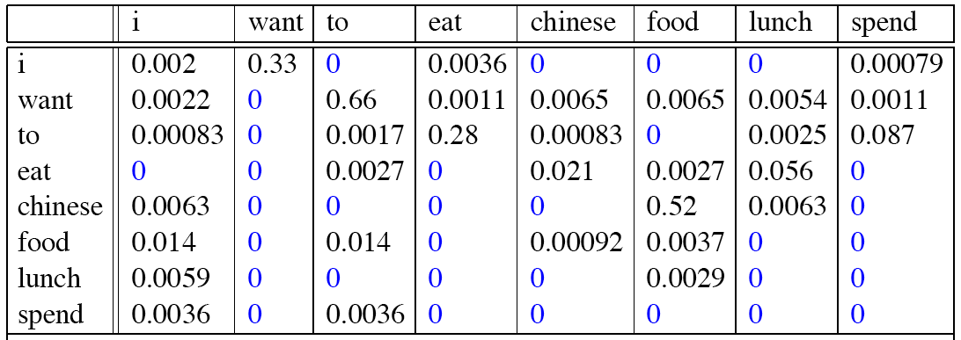
Raw bigram probabilities
Normalize by unigrams:
Result:
Notes:
Unigrams are just overall corpus counts of ”I” for example, so you would devide everything in row 1 (result) by 2533, everything in row 2 by 927…

Slide 30
Bigram estimates of sentence probabilities
P(<s> I want english food </s>) =
P(I|<s>)
× P(want|I)
× P(english|want)
× P(food|english)
× P(</s>|food)
= .000031
Notes:
Note that the probability is fairly low ( for my intuition anyway)

Slide 31
Practical Issues
We do everything in log space
Avoid underflow
(also adding is faster than multiplying)

Slide 32
Language Modeling Toolkits
SRILM
http://www.speech.sri.com/projects/srilm/
N-Gram based
KenLM
https://kheafield.com/code/kenlm/
Hugging Face (new and neural)
https://huggingface.co/course/chapter7/6?fw=pt

Slide 33
Google N-Gram Release, August 2006
…
Notes:
As recent as 2006 Google would actually release hits, n-gram models were still important, Google actually shared!
Was still available...

Slide 34
Google N-Gram Release
serve as the incoming 92
serve as the incubator 99
serve as the independent 794
serve as the index 223
serve as the indication 72
serve as the indicator 120
serve as the indicators 45
serve as the indispensable 111
serve as the indispensible 40
serve as the individual 234
http://googleresearch.blogspot.com/2006/08/all-our-n-gram-are-belong-to-you.html

Slide 35
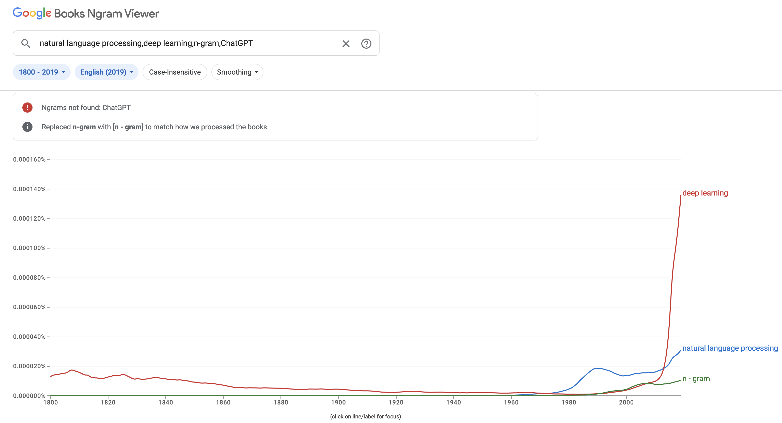
August 30th, 2023
https://books.google.com/ngrams/

Slide 36
Language Modeling
Evaluation and Perplexity

Slide 37
Evaluation: How good is our model?
Does our language model prefer good sentences to bad ones?
Assign higher probability to “real” or “frequently observed” sentences
Than “ungrammatical” or “rarely observed” sentences?
We train parameters of our model on a training set.
We test the model’s performance on data we haven’t seen.
A test set is an unseen dataset that is different from our training set, totally unused.
An evaluation metric tells us how well our model does on the test set.

Slide 38
Training on the test set
We can’t allow test sentences into the training set
We will assign it an artificially high probability when we set it in the test set
“Training on the test set”
Bad science!
And violates the honor code
Notes:
You will learn nothing

Slide 39
Extrinsic evaluation of N-gram models
Best evaluation for comparing models A and B
Put each model in a task
spelling corrector, speech recognizer, MT system
Run the task, get an accuracy for A and for B
How many misspelled words corrected properly
How many words translated correctly
Compare accuracy for A and B

Slide 40


Extrinsic Evaluations

Slide 41
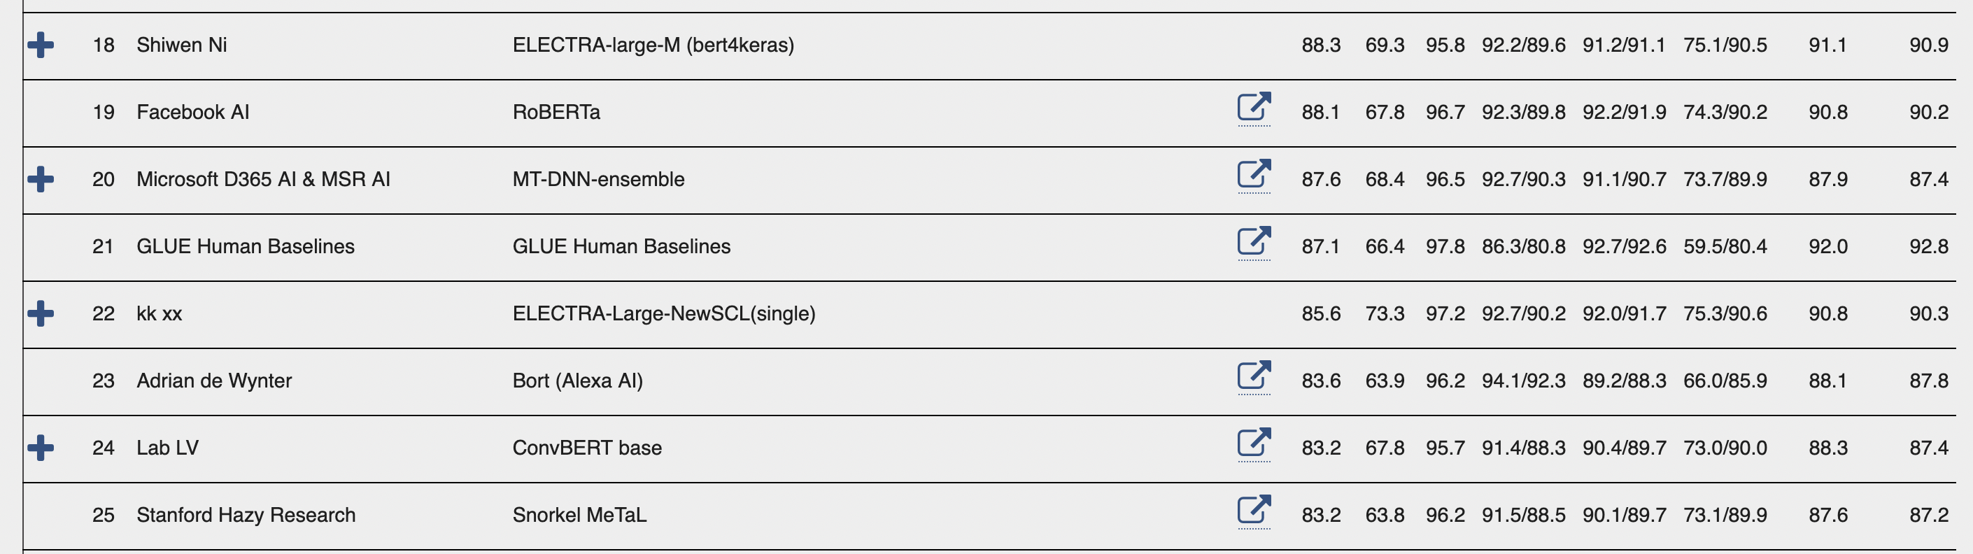
GLUE Benchmark – Human Ranking Aug 31/2022
Many tasks, some may be too easy
CoLA - Corpus of Linguistic Acceptability (CoLA)
“full form consists of 10657 sentences from 23 linguistics publications, expertly annotated for acceptability (grammaticality) by their original authors”
Notes:
Semantic textual similarity STS-B
Where is human performance? Down to 23 today, not much difference, not used so much anymore, too easy

Slide 42
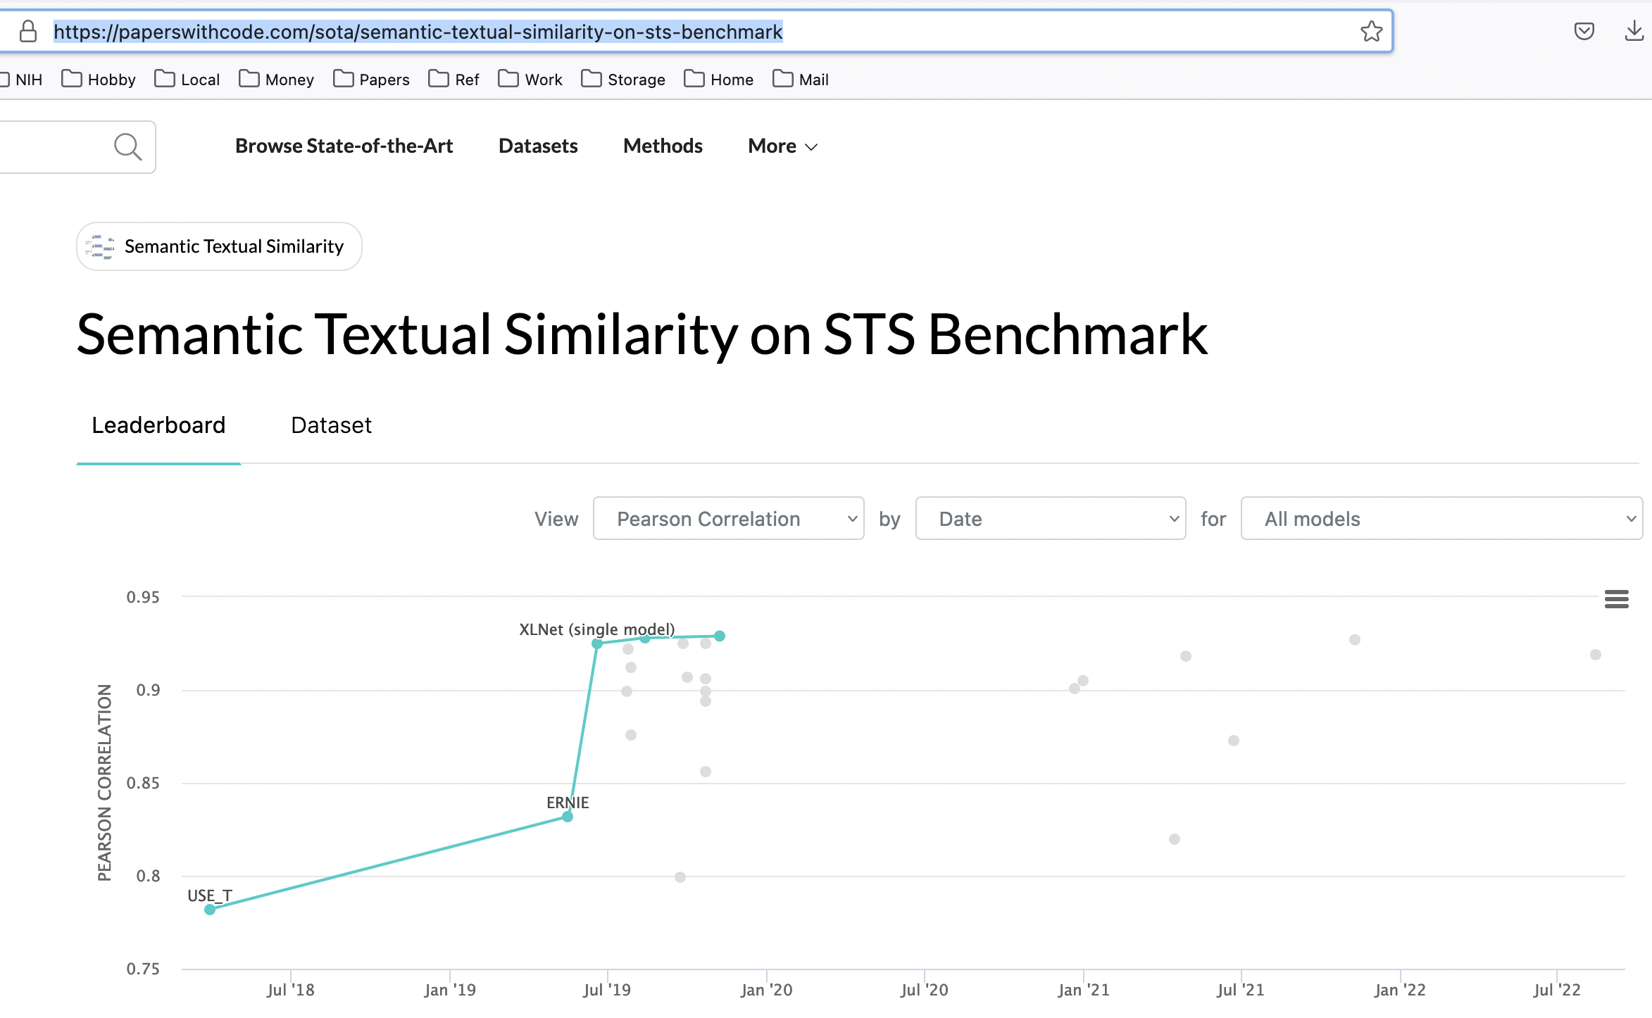
Notes:
Zoom in on tasks at this location, good place to find data and benchmarks, quite incomplete though, still need literature search

Slide 43
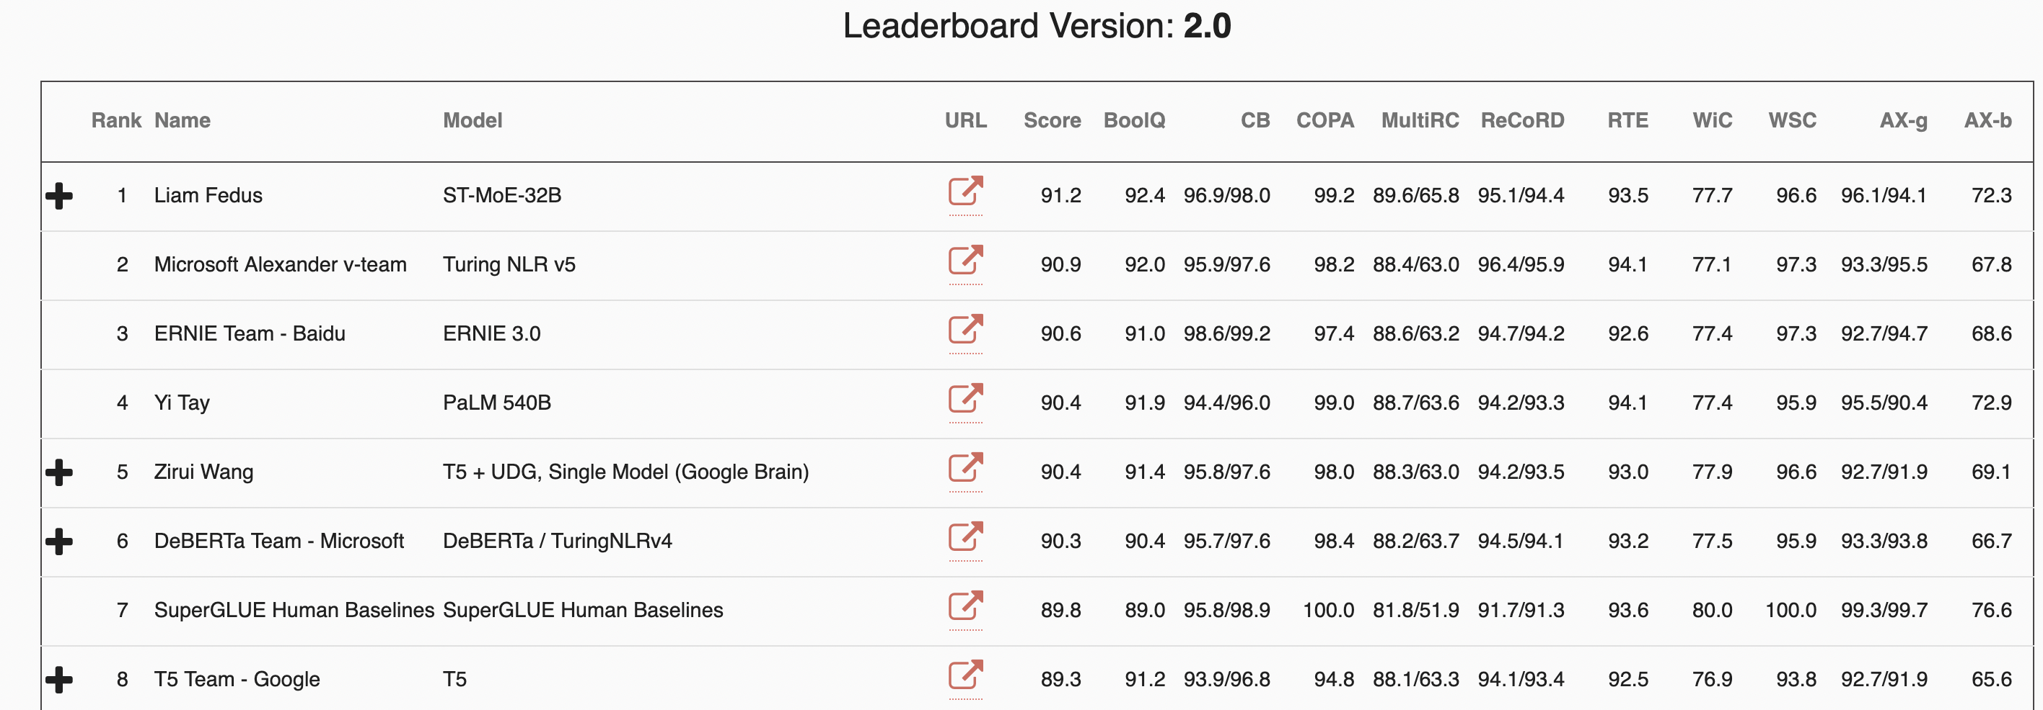
SuperGLUE: August 31st, 2022
Need new tasks?
Besides being better at other things, in what way (not measured here) is the human brain still better than all these models on all these tasks?
Notes:
New tasks
Liam Fedus at Google Brain, Yi Tay is Google as well (Singapore)
Human is now down to 8 as of August 30th, 2023, group “JD Explore Acadmey” with 6B Vega model now first (international collaboration?)

Slide 44
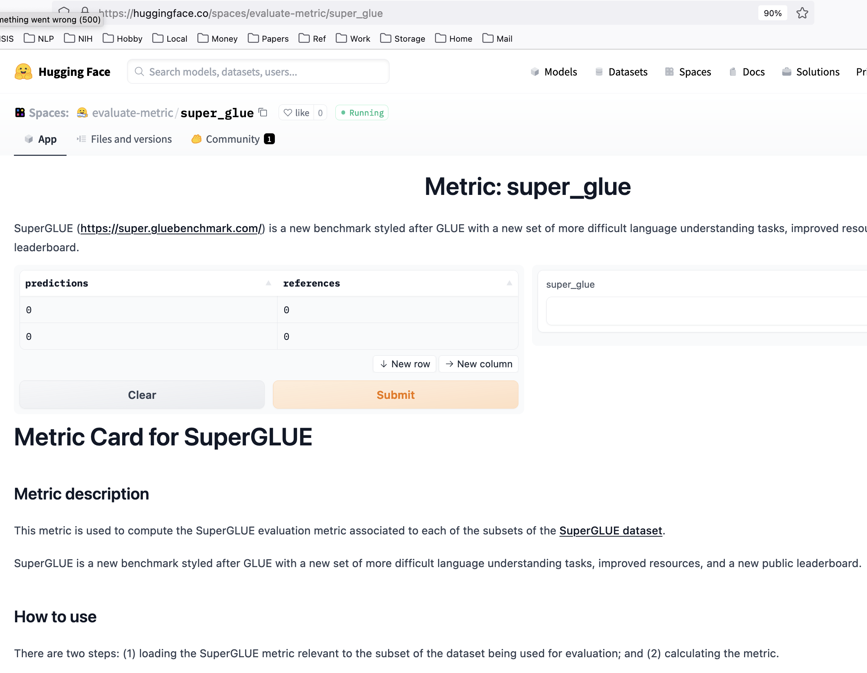
Notes:
Easier to run benchmarks now, most language models will report

Slide 45
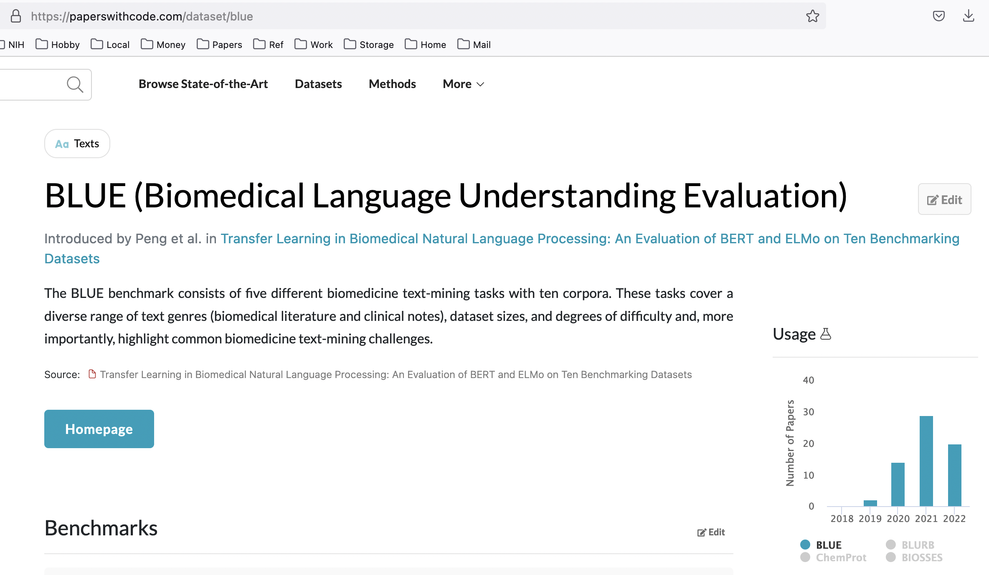
Notes:
Best for biomedical space…

Slide 46
Difficulty of extrinsic (in-vivo) evaluation of N-gram models
Extrinsic evaluation
Time-consuming; can take days or weeks
So
Sometimes use intrinsic evaluation: perplexity
Bad approximation
unless the test data looks just like the training data
So generally only useful in pilot experiments
But is helpful to think about.
Notes:
Hugging face can help, but it still can just take a long time for the model to run

Slide 47
Intuition of Perplexity
mushrooms 0.1
pepperoni 0.1
anchovies 0.01
….
fried rice 0.0001
….
and 1e-100
The Shannon Game:
How well can we predict the next word?
Unigrams are terrible at this game. (Why?)
A better model of a text
is one which assigns a higher probability to the word that actually occurs
I always order pizza with cheese and ____
The 33rd President of the US was ____
I saw a ____

Slide 48
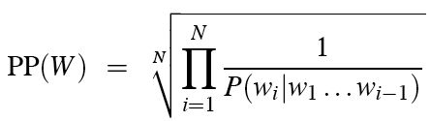
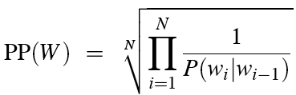
Perplexity
The best language model is one that best predicts an unseen test set
Gives the highest P(sentence)
Perplexity is the inverse probability of the test set, normalized by the number of words:
Chain rule:
For bigrams:
Minimizing perplexity is the same as maximizing probability
Notes:
P(w1w2w3…wN) is the probability estimate assigned to the word sequence (w1,w2…wn) by a language model
exponential average of a sequence’s negative log likelihoods
-no rule on what I is, could use whatever, no actual need for in in this simple sense, will depend on what kind of model you are using

Slide 49
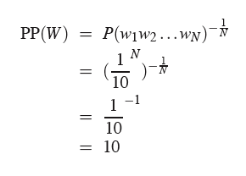
Perplexity as Weight Average Branching Factor
“The branching factor of a language is the number of possible next words that can follow any word”
Let’s suppose a sentence consisting of random digits
What is the perplexity of this sentence according to a model that assign P=1/10 to each digit?
Notes:
Bit confusing since it assumes that 1/10 digit assignment for your corpus
Real model may be close to Benford’s law
Benford's law, also known as the Newcomb–Benford law, the law of anomalous numbers, or the first-digit law, is an observation that in many real-life sets of numerical data, the leading digit is likely to be small.
Similar idea to Zipf’s law we will discuss later…

Slide 50
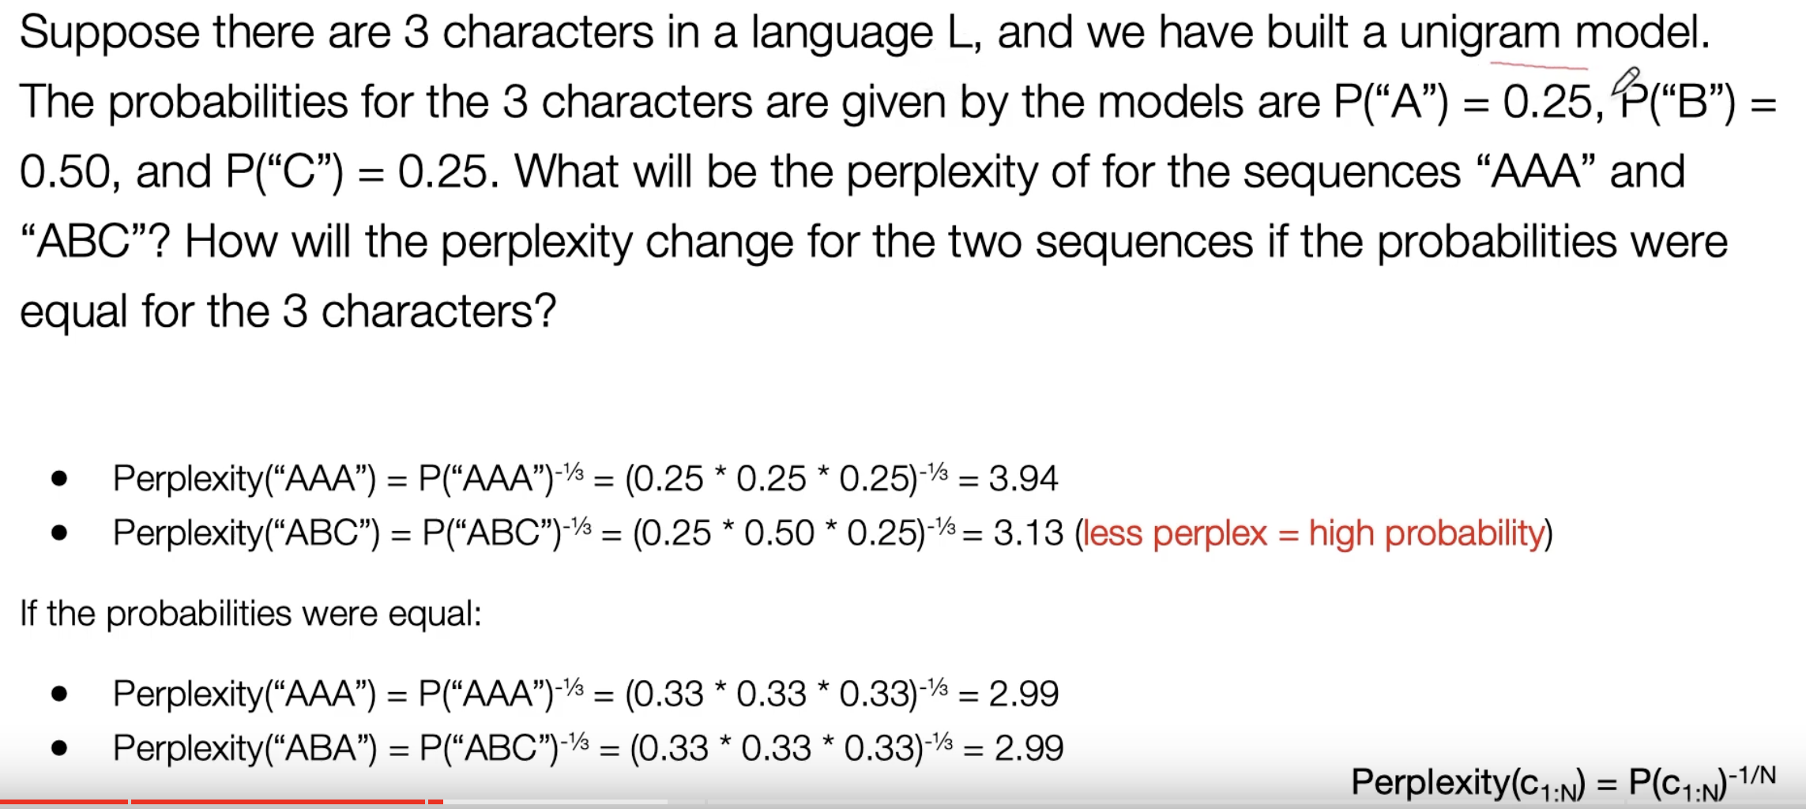
Perplexity: Model Probabilities on a Specific Corpus
https://www.youtube.com/watch?v=GkG-P12B4u0
Notes:
Perplexity isn’t intrinsic probability of a model, it is intrinsic property as shown on a particular corpus

Slide 51
Lower perplexity = better model
Best language model is the one that best predicts the input corpus / document / sequence
Training 38 million words, test 1.5 million words, WSJ
N-gram Order | Unigram | Bigram | Trigram
Perplexity | 962 | 170 | 109

Slide 52
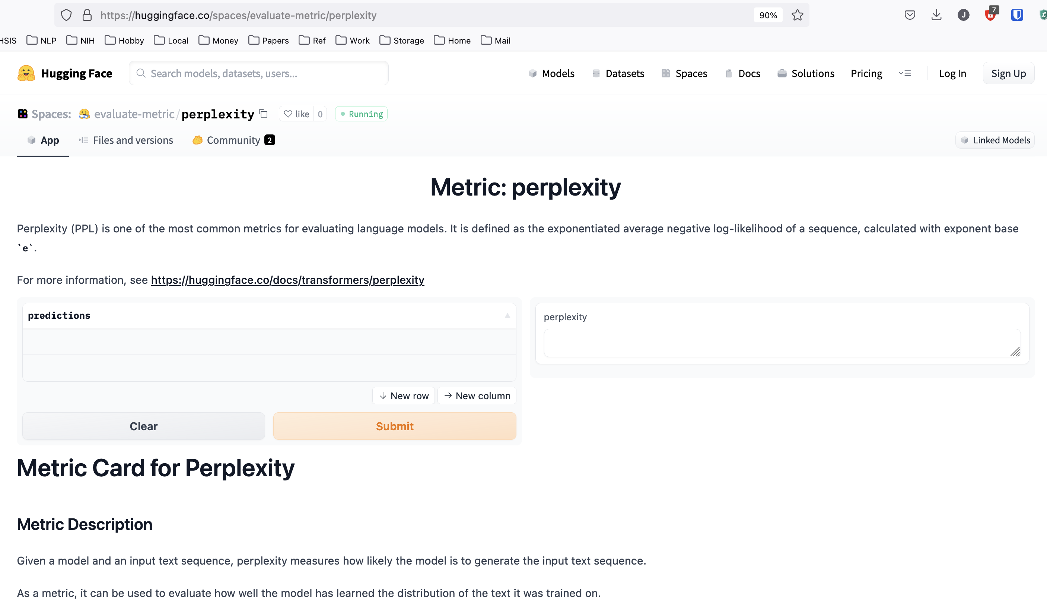
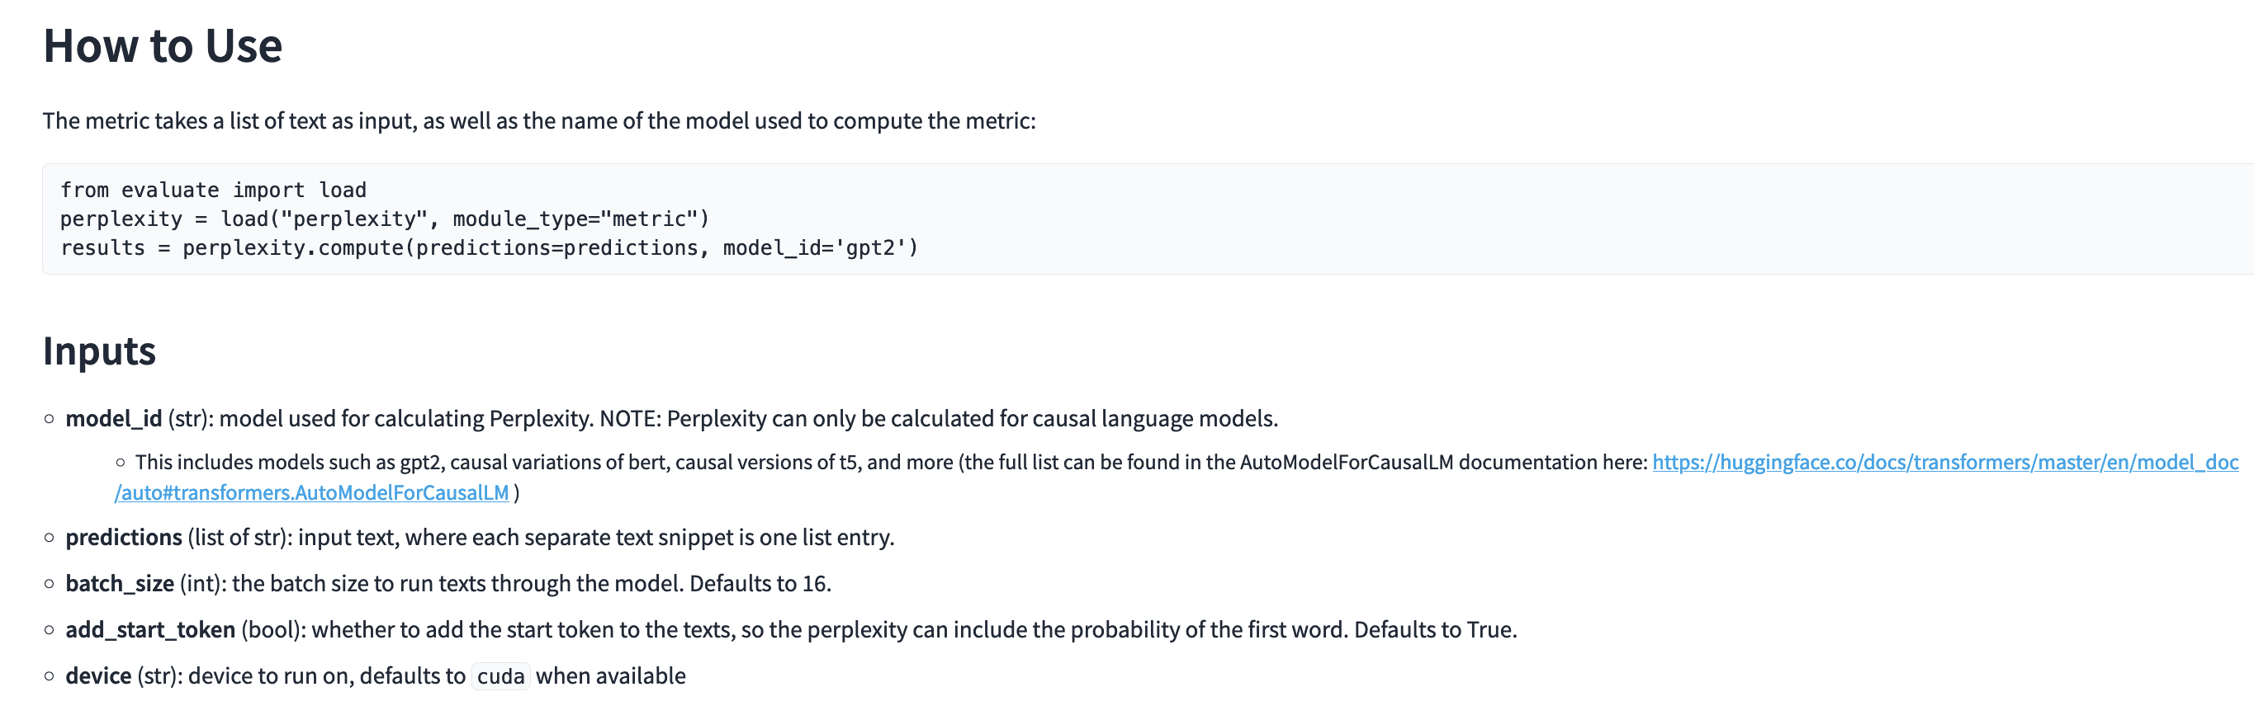
May be useful for your homework!
Notes:
People really do show these results, but also use SuperGlue

Slide 53
Language Modeling
Generalization and zeros

Slide 54
The Shannon Visualization Method
Choose a random bigram
(<s>, w) according to its probability
Now choose a random bigram (w, x) according to its probability
And so on until we choose </s>
Then string the words together
<s> I
I want
want to
to eat
eat Chinese
Chinese food
food </s>
I want to eat Chinese food
Notes:
NLG
Another way to evaluate a model qualitatively

Slide 55
Approximating Shakespeare

Slide 56
Shakespeare as corpus
N=884,647 tokens, V=29,066
Shakespeare produced 300,000 bigram types out of V²= 844 million possible bigrams.
So 99.96% of the possible bigrams were never seen (have zero entries in the table)
Quadrigrams worse: What's coming out looks like Shakespeare because it is Shakespeare

Slide 57
The wall street journal is not shakespeare (no offense)

Slide 58
Can you guess the author of these random 3-gram sentences?
They also point to ninety nine point six billion dollars from two hundred four oh six three percent of the rates of interest stores as Mexico and gram Brazil on market conditions
This shall forbid it should be branded, if renown made it empty.
“You are uniformly charming!” cried he, with a smile of associating and now and then I bowed and they perceived a chaise and four to wish for.
Notes:
Which corpus

Slide 59
The perils of overfitting
N-grams only work well for word prediction if the test corpus looks like the training corpus
In real life, it often doesn’t
We need to train robust models that generalize!
One kind of generalization: Zeros!
Things that don’t ever occur in the training set
But occur in the test set

Slide 60
Zeros
Training set:
… denied the allegations
… denied the reports
… denied the claims
… denied the request
P(“offer” | denied the) = 0
Test set
… denied the offer
… denied the loan

Slide 61
Zero probability bigrams
Bigrams with zero probability
mean that we will assign 0 probability to the test set!
And hence we cannot compute perplexity (can’t divide by 0)!

Slide 62
Language Modeling
Smoothing: Add-one (Laplace) smoothing

Slide 63
The intuition of smoothing (from Dan Klein)
When we have sparse statistics:
Steal probability mass to generalize better
P(w | denied the)
3 allegations
2 reports
1 claims
1 request
7 total
allegations
attack
man
reports
outcome
…
claims
request
P(w | denied the)
2.5 allegations
1.5 reports
0.5 claims
0.5 request
2 other
7 total
allegations
allegations
attack
man
outcome
reports
…
claims
request

Slide 64
Add-one estimation
Also called Laplace smoothing
Pretend we saw each word one more time than we did
Just add one to all the counts!
MLE estimate:
Add-1 estimate:
Notes:
What is V?

Slide 65
Maximum Likelihood Estimates
The maximum likelihood estimate
of some parameter of a model M from a training set T
maximizes the likelihood of the training set T given the model M
Suppose the word “bagel” occurs 400 times in a corpus of a million words
What is the probability that a random word from some other text will be “bagel”?
MLE estimate is 400/1,000,000 = .0004
This may be a bad estimate for some other corpus
But it is the estimate that makes it most likely that “bagel” will occur 400 times in a million word corpus.

Slide 66
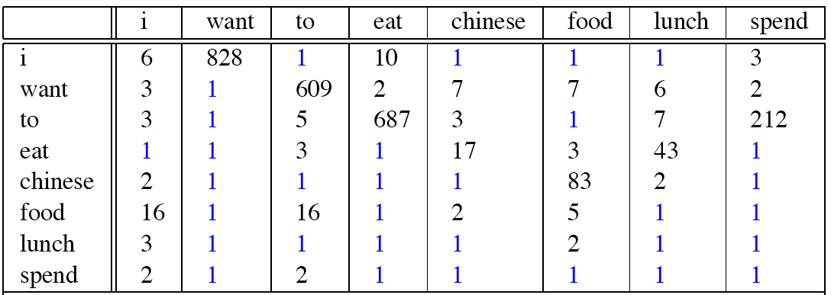
Berkeley Restaurant Corpus: Laplace smoothed bigram counts
Notes:
Everything adds 1, ”I want” used to be 827

Slide 67
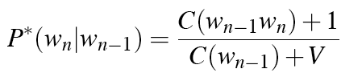
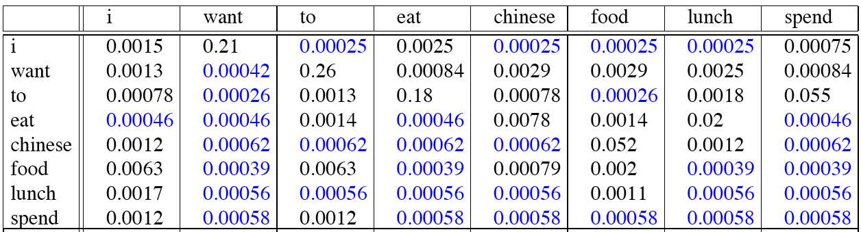
Laplace-smoothed bigrams
Notes:
Only a subset of corpus, don’t expect probabilities in this table to add up to 1
Other words can come after i besides the ones shown here

Slide 68
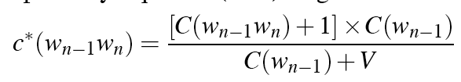
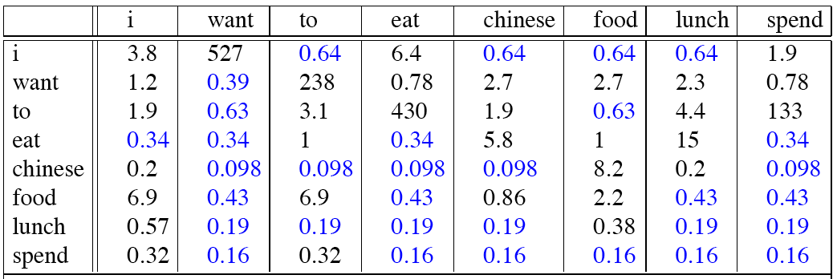
Reconstituted counts
Notes:
Generate our new count estimates for the corpus after smoothing, cell i want was 827, +1 to get 828, now 527?
Why reduced?
Why are zeroes not the same?
Just like old slide, expect now we are multiplying by C(wn-1) which is the old count

Slide 69
Compare with raw bigram counts
Notes:
C(want to) went from 608 to 238, P(to|want) from .66 to .26!
Discount d= c*/c
d for “chinese food” =.10!!! A 10x reduction. Why so much? (Chinese very common prefix for food, “Chinese food” was bigger proportion of #)

Slide 70
Add-1 estimation is a blunt instrument
So add-1 isn’t used for N-grams:
We’ll see better methods
But add-1 is used to smooth other NLP models
For text classification
In domains where the number of zeros isn’t so huge.

